Slide 1
CampusCare
Smart Campus Issue Management and Resolution System
TEAM MEMBERS
PROJECT DETAILS
Sufiyan Khan
Sufiyan Nagori
Roshan Jat
Sumit Yadav
Divyanshu Geel
Portal ID: PBL2627-AI&DS-C-021
Branch: AI&DS-C (2026–27)
Guide: Er. Ram Babu Buri
[College Name Placeholder]

Slide 2
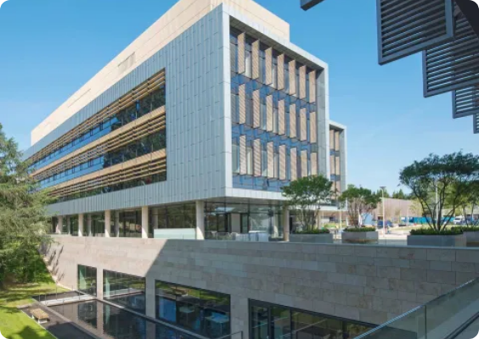
Introduction
Digitizing campus issue resolution.
CampusCare replaces fragmented manual reporting with a unified Windows desktop application.
Format: Native Windows desktop executable.
Routing: Automated department-level ticket dispatch.
Scope: End-to-end local infrastructure management.
Introduction
02

Slide 3



The Problem
Messaging
Phone Calls
Lost in chat history.
No verifiable record.
Registers
Verbal
Slow manual tracking.
Zero accountability.
Problem Statement
03

Slide 4
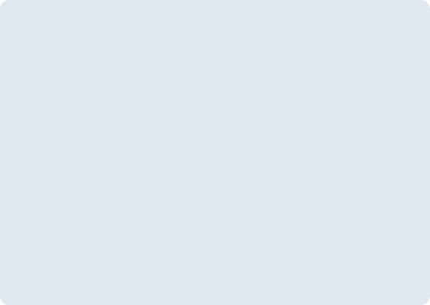
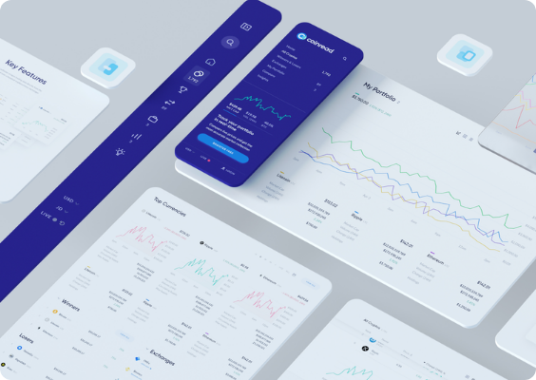



Proposed Solution
Centralized Management
Single hub for all complaints.
Automated Routing
Direct department mapping.
Transparent Tracking
Real-time status updates.
Proposed Solution
04

Slide 5
Project Objectives
01
Digitize manual complaint reporting.
02
Improve operational transparency.
03
Increase departmental accountability.
04
Support data-driven campus management.
Objectives
05

Slide 6
Project Scope
In Scope (Implemented)
Out of Scope (Future)
Windows Desktop environment.
Web or mobile applications.
3 Roles (Admin, Staff, Student).
Cloud/centralized databases.
7 core functional modules.
External SMS/Email gateways.
Local SQLite database.
Multi-campus support.
Scope & Limitations
06

Slide 7
System Comparison
Feature | Existing Methods | CampusCare (Proposed)
Records | Scattered or unrecorded. | Centralized SQLite database.
Status Tracking | Manual follow-ups required. | Real-time lifecycle tracking.
Assignment | Ambiguous responsibility. | Direct department mapping.
Feedback | No structured mechanism. | Post-resolution rating system.
Analytics | Impossible to aggregate. | Automated trend reports.
Existing vs Proposed
07

Slide 8




Functional Modules
Security & Auth
Complaint Reporting
Tracking & History
Role-based access control.
Categorized issue submission.
Real-time lifecycle logs.
Staff Resolution
In-App Notifications
Analytics & Feedback
Task assignment dashboard.
Instant status alerts.
Post-resolution user ratings.
Admin Management
System and user oversight.
System Modules
08

Slide 9






User Roles & Responsibilities
Student
Staff
Admin
Submit complaints.
Accept assigned tasks.
Manage user accounts.
Track active status.
Update issue progress.
Configure categories.
Provide resolution feedback.
Mark as resolved.
View system analytics.
Roles & Use Cases
09

Slide 10








Technology Stack
Java 21
JavaFX & CSS
SQLite & JDBC
Maven
High-performance core logic.
Hardware-accelerated UI.
Zero-configuration storage.
Dependency automation.
FXML
BCrypt
jpackage
VS Code
Decoupled view markup.
Cryptographic salting.
Native OS executable.
Primary development IDE.
Approved Technology Stack
10

Slide 11
System Architecture
Presentation Layer (JavaFX / FXML / CSS)
Controller Layer (Event Handling)
Service Layer (Business Logic & Auth)
DAO Layer (Data Access Objects via JDBC)
SQLite Database (Local Storage)
Layered Architecture
11

Slide 12
Database Entities (Core ER Model)
DEPARTMENTS
COMPLAINTS
PK dept_id
dept_name
USERS
PK user_id
username
password_hash
role (Enum)
PK complaint_id
FK user_id (Student)
FK dept_id
status, priority
title, description
HISTORY / TRACKING
PK history_id
FK complaint_id
status_change
Simplified Schema
12

Slide 13
Complaint Lifecycle Workflow
1
2
3
4
5
6
SUBMITTED
ASSIGNED
ACCEPTED
IN PROGRESS
RESOLVED
CLOSED
Reopening Path: RESOLVED → REOPENED (by Student) → ASSIGNED
Designed Process Flow
13

Slide 14



UI Workflow (Placeholders)
[Login / Registration UI]
[Student Dashboard & Tracking]
[Complaint Submission Form]
[Staff Task Dashboard]
Interface Mocks
14

Slide 15


Security & Non-Functional Requirements
Password Hashing
SQL Injection Prevention
BCrypt algorithm with dynamic salting.
Parameterized JDBC PreparedStatements.
Role-Based Access
Input Validation
Strict UI and database isolation.
Strict JavaFX regex form constraints.
System Integrity
15

Slide 16
End-to-End Acceptance Scenario
Test Input
Student reports: "Bus AC not working". Category: Transport. Location: Bus No 3. Priority: HIGH.
Step 1
Step 2
Step 3
Step 4
System auto-maps to Transport Dept.
Staff views task on dashboard.
Staff marks resolved.
Student rates the fix.
Planned System Verification
16

Slide 17
Outcomes & Future Scope
Expected Outcomes
Future Scope (Planned)
Better complaint visibility.
Native Android application.
Centralized digital records.
Cloud DB (Multi-campus).
Improved staff accountability.
AI priority prediction.
Data-driven trend analysis.
Duplicate anomaly detection.
Roadmap
17

Slide 18
Thank You
Questions & Evaluation
PROJECT EXECUTION TEAM
Sufiyan Khan
Sufiyan Nagori
Roshan Jat
Sumit Yadav
Divyanshu Geel

Slide 19



Image Sources
https://www.southampton.ac.uk/sites/default/files/styles/large/public/2020-06/boldrewood-exterior-sunny-day.jpg.webp?itok=JBIZVNCS
Source: www.southampton.ac.uk
https://media.istockphoto.com/id/2165204882/photo/messy-file-folders-and-business-records-red-tape-bureaucracy-overworked-beat-the-clock.jpg?s=612x612&w=0&k=20&c=sUv8uG8bAO0WQmbAIfC8NYkZFNyKwPBx3XxFZ2Y709s=
Source: www.istockphoto.com
https://miro.medium.com/v2/resize:fit:1400/0*-T8JClBXfWAN6ZU_
Source: medium.com

